Slide 1

UNION SELECT * FROM hackers;
Why We Should be Building InfoSec Worker Power Through the Labor Movement
Logan Arkema (@LoganArkema)
Slides and Resources available at https://larkema.github.com/Unions
Notes:
Hi Everyone,
This is ‘UNION SELECT * FROM hackers; Why We Should Be Building InfoSec Worker Power Through the Labor Movement’
I’m Logan Arkema – just @LoganArkema most places on the internet – and the slides and resources I mention throughout the talk are available on GitHub, which I’ll put up again at the end of the talk.
Hopefully, you’re here because of some interest in labor organizations, not database operations.
So, for a quick sense of the room how many folks here
Have even been in a union?
Would like to be in a union?
Are ambivalent or are here to have something to listen to over your morning coffee?
Are here to hack me or otherwise sabotage the labor movement?
I didn’t think so, but I would have admired your honesty.

Slide 2
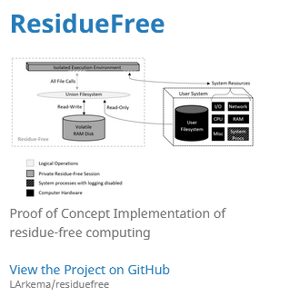
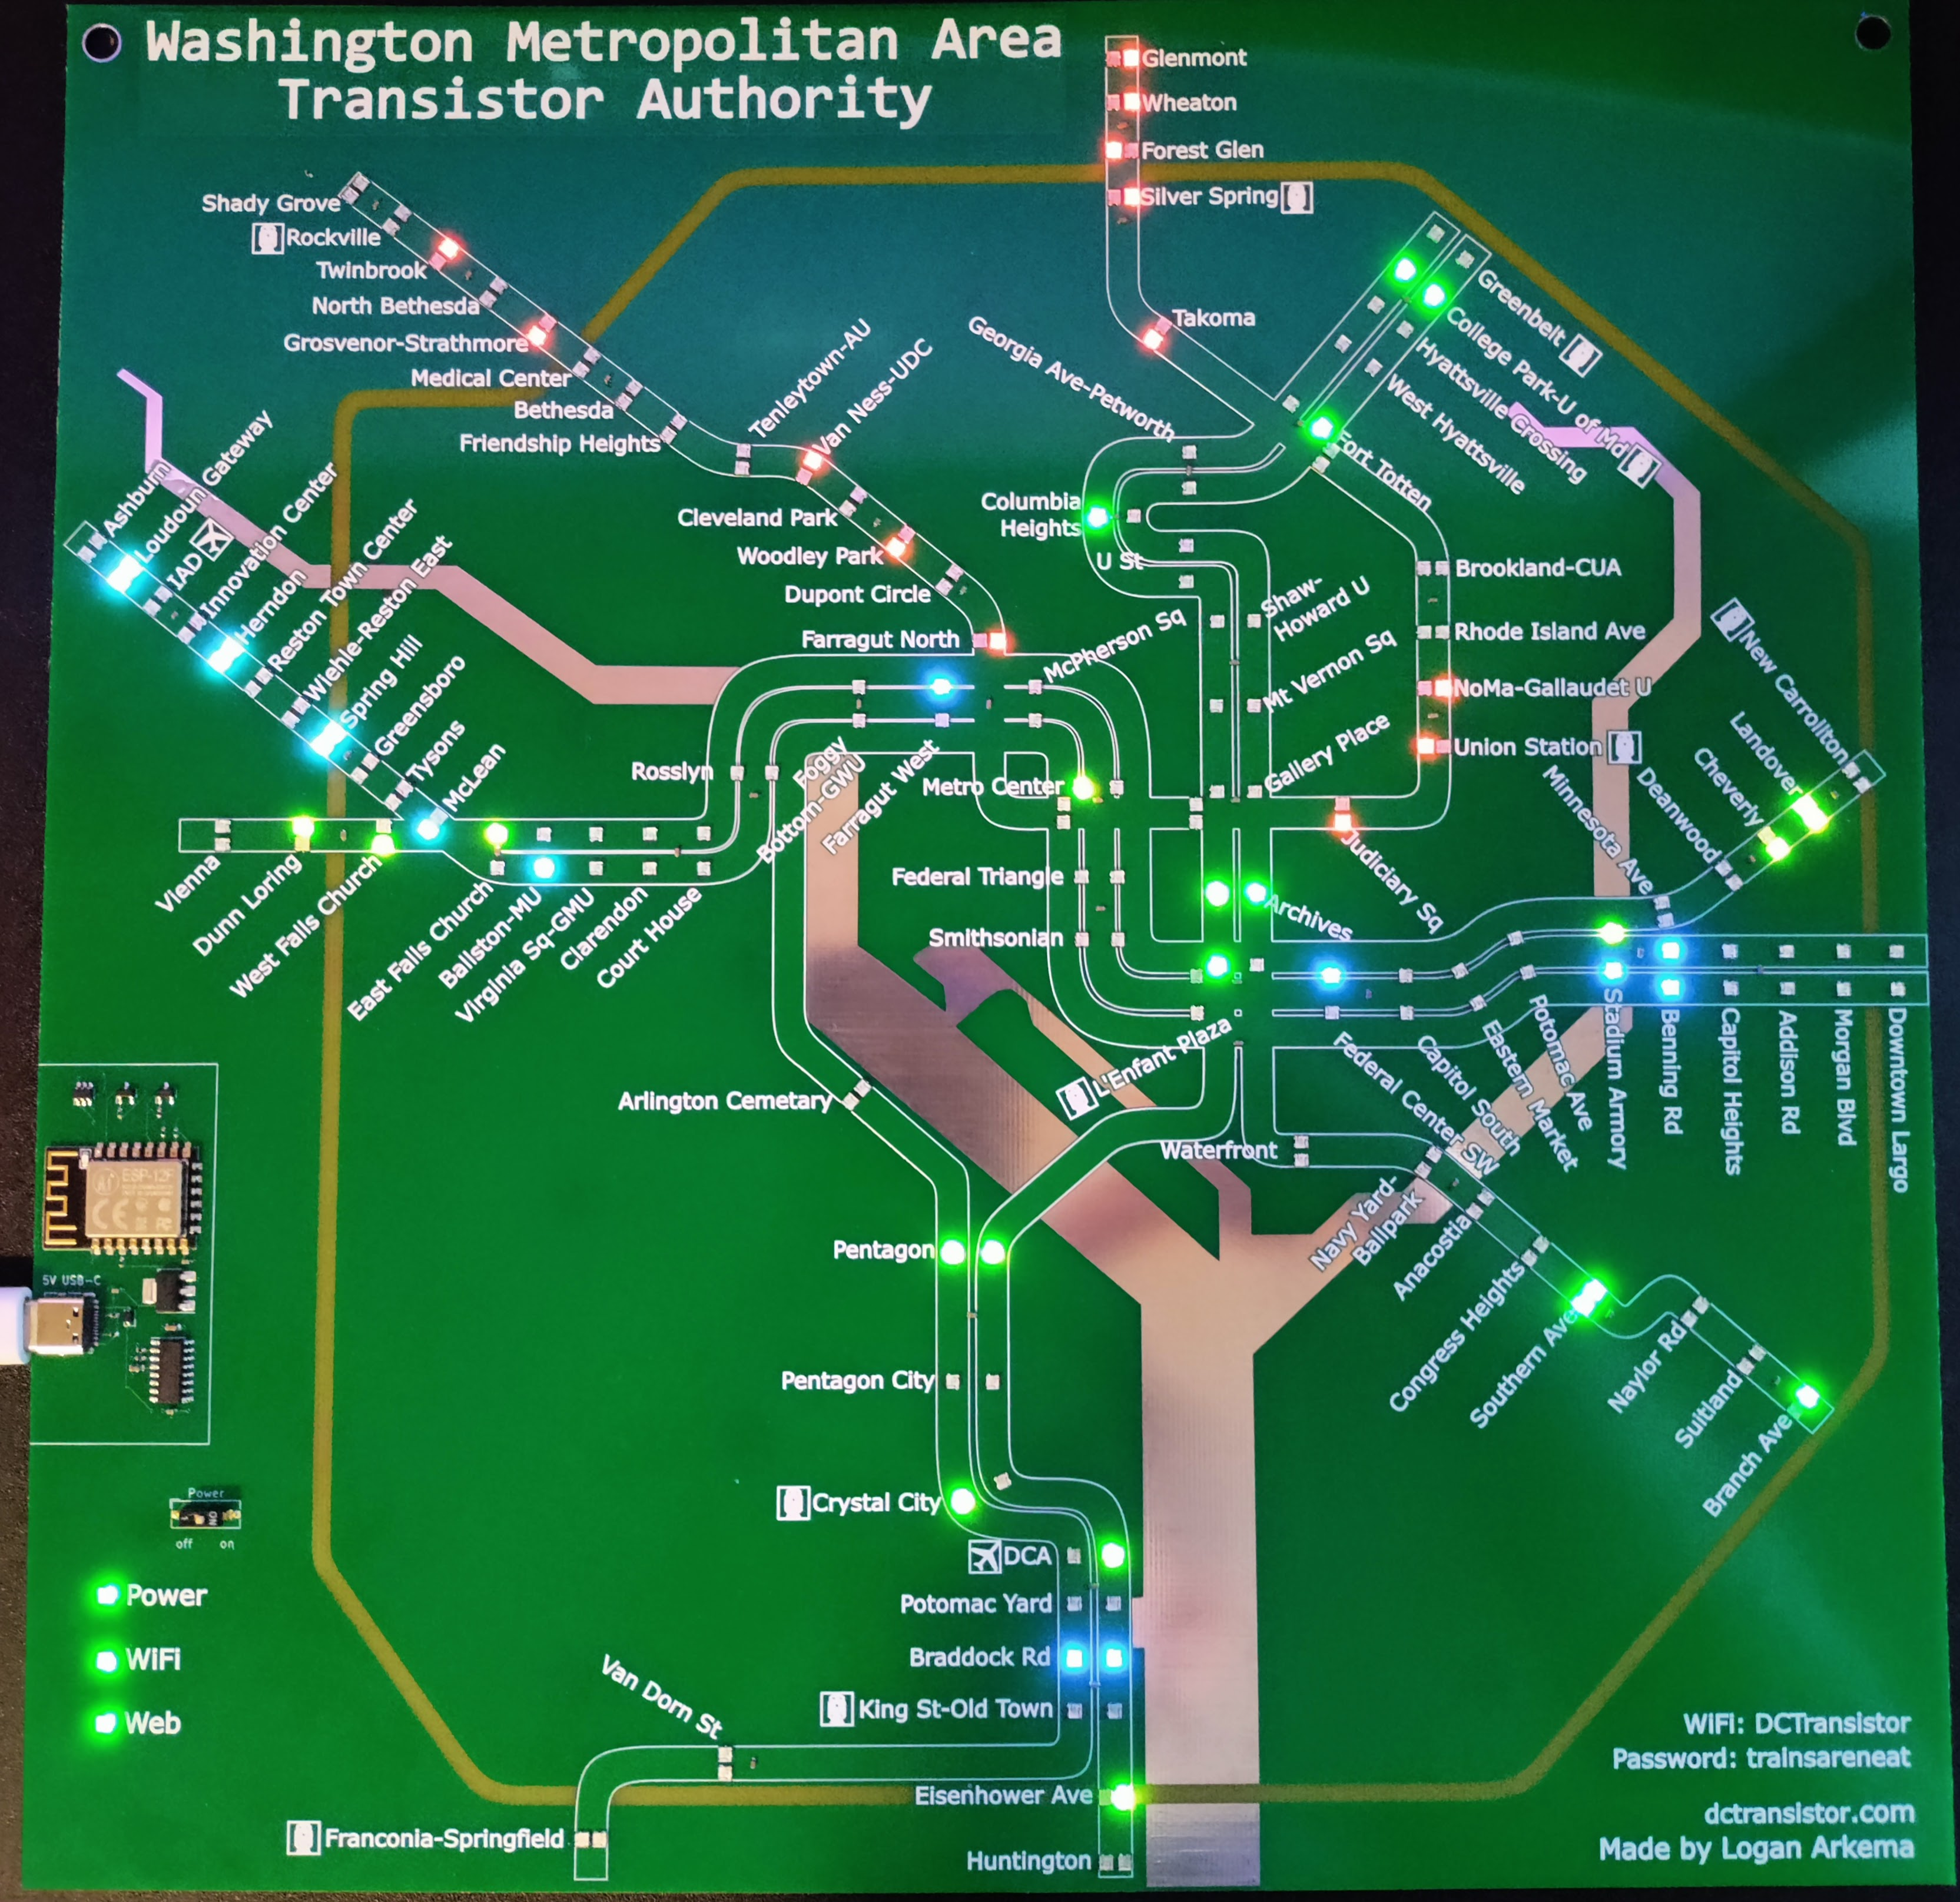
$whoami
“Sr. Cybersecurity Specialist” @ Gov Agency*
Cloud Engineer / Product Lead
Union Rep!
Tool Developer – ResidueFree
Volunteer @ DEF CON Policy, Hackers on the Hill, and BSides NoVA
“Badge” Maker – DCTransistor
Masters in Tech Law and Policy (I Am Not A Lawyer)
*The opinions and views expressed in this presentation are my own and my union local’s and do not necessarily represent the thoughts, opinions, or positions of my current employer.
Notes:
Here’s some more information on me and why I’m arguably worth listening to – or at the very least to convince you that I’m not an “outside agitator” from Big Union here to stir up trouble where I’ve got no business:
Cybersecurity is my day job. I’m a Sr. Security Specialist at a government agency – the exact one doesn’t matter – where I currently am a cloud engineer and product lead on internal efforts but have previously worked on incident response, privacy, and acquisitions.
*IMPORTANTLY* the opinions and views expressed in this presentation are my own and my union local’s and do not necessarily represent the thoughts, opinions, or positions of my current employer. This is an important point – I’m here on my own dollar talking as myself.
As I’ll get into more in a second, I’m a union rep at my job for the colleagues on my team
In my free time, I’ve developed a tool and a large blinky badge, volunteered at various cons and community events, and went to law school for a tech law degree, including labor law. I am not a lawyer and none of this is legal advice, but my knowledge on legal issues isn’t coming from nowhere

Slide 3

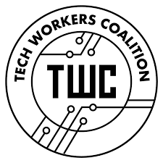

$whoami --all-labor
Union Rep for 5 Years w/ International Federation of Professional and Technical Engineers
IT & Cybersecurity Team Rep
Bargaining, Dispute Resolution, Advocacy
Tech Workers Coalition (TWC)
Federal Unionist Network
Notes:
To dive into why you should listen to me on labor topics specifically:
As I mentioned earlier, I’ve been a Union Rep for 5 years at my local, which is under the International Federation of Professional and Technical Engineers or IFPTE – because international unions love convoluted acronyms almost as much as the tech industry.
I represent my agency’s IT & Cybersecurity Team in our union’s day-to-day work and have been involved in our main bargaining, dispute resolution, and advocacy work.
I also organize with two grassroots, worker-led labor movements: the Tech Workers Coalition and the Federal Unionist Network

Slide 4
$whoami
Some Guy
Notes:
Most importantly about my background: [ANIMATION]
I am some guy. There’s nothing that special about me, despite what my mom says.
I have no black badges, CVEs, or 1337 stories of getting Domain Admin or hunting nation state hackers
If I can do the stuff covered in this presentation, you can too. It can be very daunting work, but it’s not work that can be practiced in a home lab or CTF, or that you can get a cert for. No one really knows how to do it until they do it. That means the only way for you to be confident doing it - is to start.

Slide 5
The Current Moment™
Notes:
I would like to start, if I may, start by offering some thoughts on the current moment TM – both broadly - and specifically for us as a community and workforce - compared to where we were a year ago.
I’ll then give my thoughts on what makes the hacker community particularly equipped to meet this moment and to organize our labor
After that, I’ll talk about unions generally and how our community and industry could fit into the labor movement framework
And I’ll conclude with some thoughts on why we really need to organize *as workers* right now with some concrete next steps

Slide 6
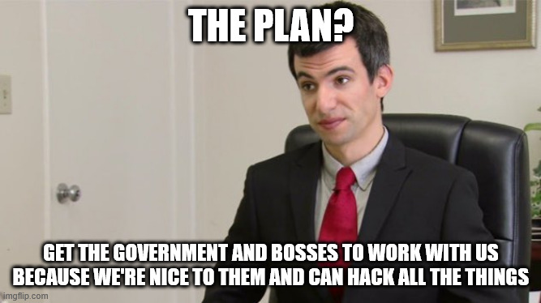
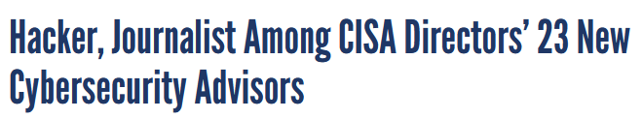
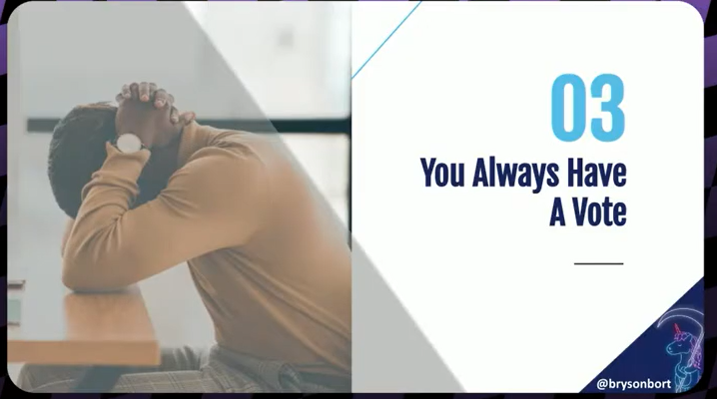
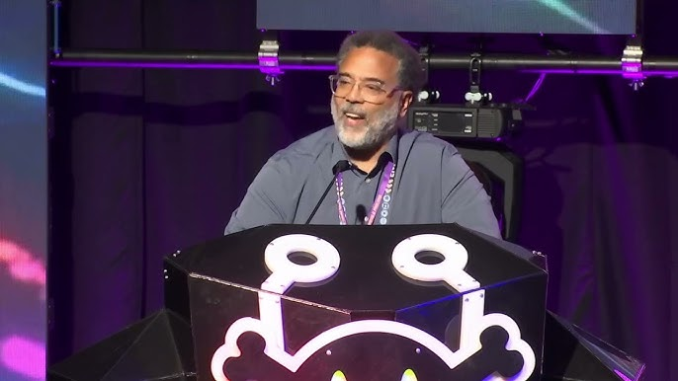
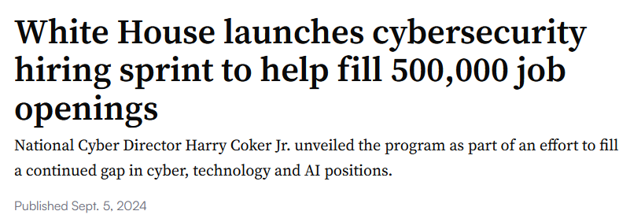
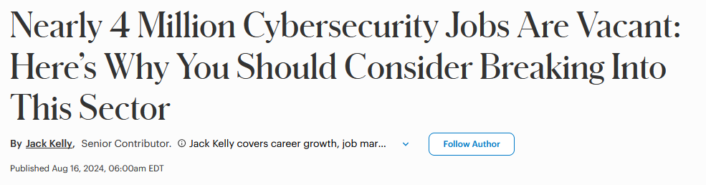
Remember The Plan?
Notes:
Going back a year or more, who remembers the plan? [pause]
Specifically, the plan for how we – hackers and InfoSec workers – were going to build and maintain political influence [] so the Feds didn’t go back to hunting us for sport [] and were going to maintain high demand for our labor [] so we always had job security? [pause]
If you don’t remember, it’s probably because there wasn’t much of a formal plan beyond some vibes.
To the extent there was a plan to build and maintain political influence, a lot of it was dedicated to building Dark Tangent’s Rolodex. That may be hyperbolic, but a lot of the work to build this community’s political influence, came down to high-profile names building individual relationship with policymakers and journalists then using those relationships to speak on behalf of the community with very little accountability to or material input from this community at large. We’ve been doing policy advocacy fueled by personal brands.
This type of influence isn’t inherently bad – I’m not complaining the National Cyber Director regularly came here to tell us we’re important, especially compared to more historic outright hostility - but it’s a fragile type of influence.
As workers, we were able to coast on scarcity to create high demand for our labor. The demand may have been dramatically over-reported, but it kept our salaries high and our negotiating power strong.
Basically, we haven’t really had to grapple with where our power comes from when it doesn’t come from our individual relationships or scare skills, and we’re still stuck in this mindset! This slide is from Monday Morning’s opening keynote, which was overall well-done if you didn’t get the chance to see it, but the slide refers to voting with your feet by leaving a bad boss! I wanted to yell, because you can literally, actually, democratically vote over your working conditions

Slide 7
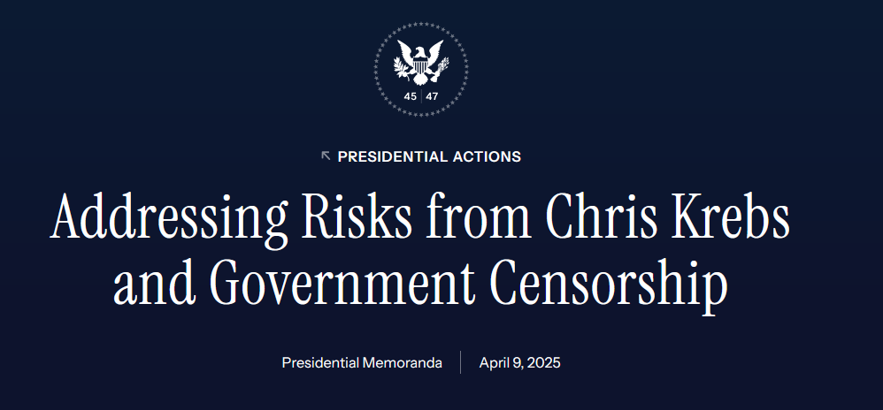
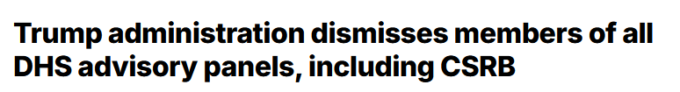
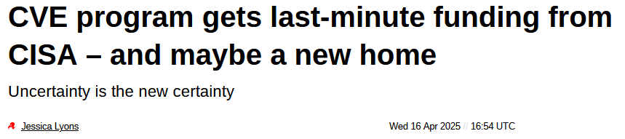
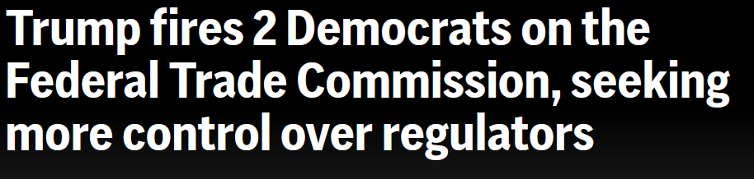
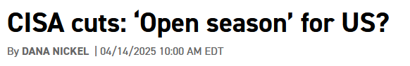
So, Things Aren’t Great
Notes:
Cut to today, and things aren’t going great. This is most obvious in government, where a new administration has actively targeted leaders of our community for doing their jobs and doing them well.
They removed the voices from our community that were given formal government roles, like DT’s advisory role.
They cut our peers’ jobs – or pushed them to leave - who were doing deeply important work to protect public-interest systems and provide free resources to the rest of us.
They barely sustained the CVE data that serves as a foundation for our industry.
And they removed oversight officials who stood to hold companies and other government agencies accountable for running insecure, immature cybersecurity and privacy programs.
The totalitarians in government have been on a rampage replacing competent professionals with “yes, men.” This isn’t just dangerous for our republic – it’s especially dangerous in our field where quickly and honestly reporting bad news is essential to keeping systems, data, and people safe.

Slide 8
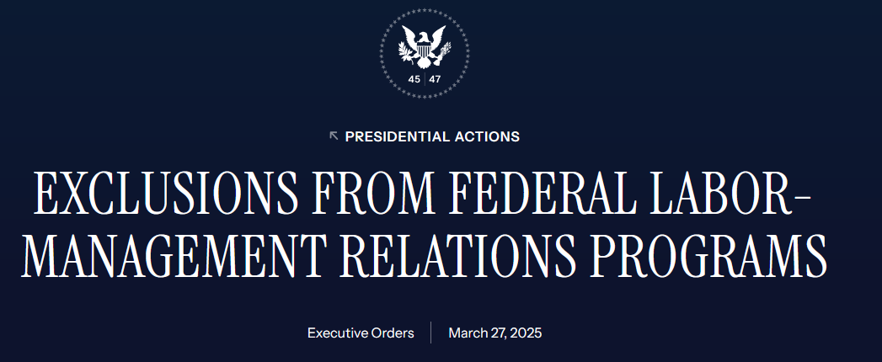
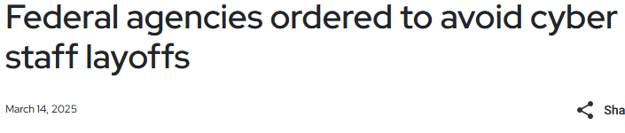
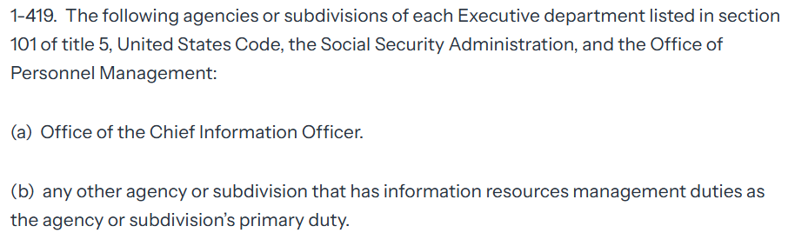
Hey, That’s Us!
Notes:
Not to worry! The push to quash our ability to dissent, raise alarms, and have protections on the job through union representation and collective bargaining has a carve-out for IT and Cybersecurity workers!
It specifically carves us out of those protections, allegedly for “national security reasons.” Just Monday a federal appeals court affirmed that the President can essentially say any federal job is critical enough for national security to lose union protections, even if the job requires no clearance.
If anything demonstrates the criticality of our work – it’s that we were explicitly excluded from layoff targets at the same time we were excluded from union protections. They know they need us and our labor to keep the machine running – they just don’t want us to be able to say something about it or do anything other than run the machine in the way they say.
The feds are back to hunting us for sport – not for DMCA or CFAA violations, but because we could possibly slow them down.

Slide 9
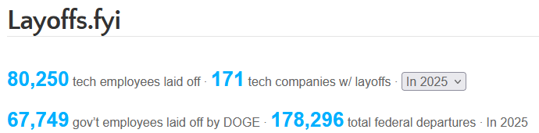
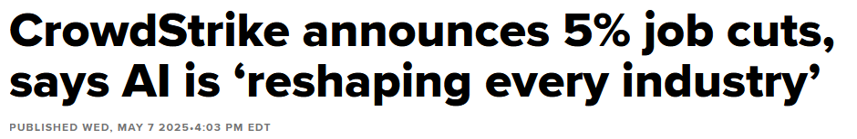
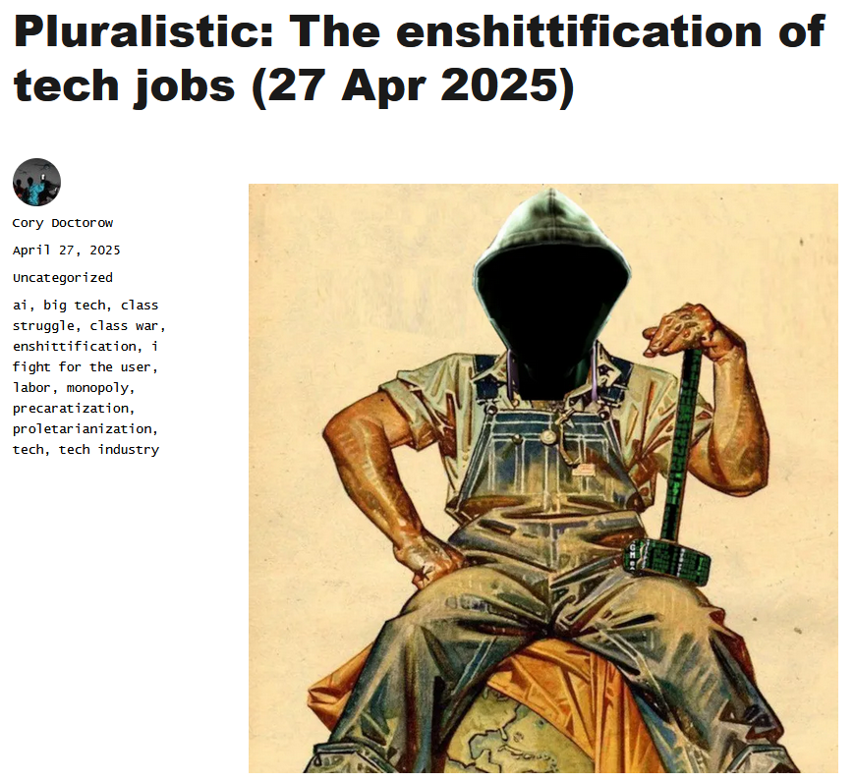
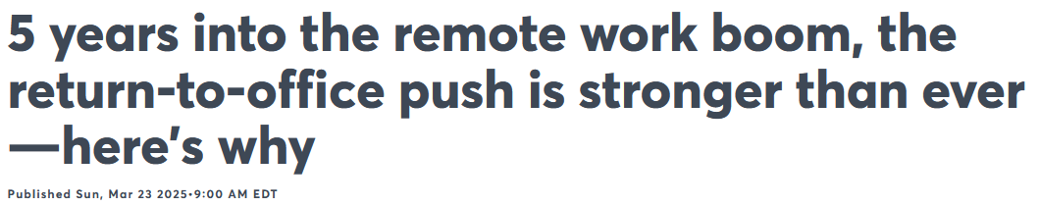
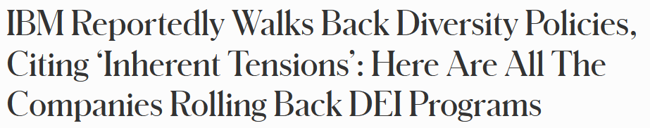
And That’s the Rest of Us!
Notes:
For those of us in the private sector, our jobs may not be directly targeted by a new administration, but many of our contracts and funding dried up and our bosses sure have been emboldened to tighten the screws.
Over the past few years, layoffs have been sweeping the tech industry and we know the job market isn’t what it was years ago.
Our bosses have been fed the narrative that AI can successfully and competently take over our work – something that those of us who have spent more than a day being forced to shape our workflow around a new AI tool know isn’t true – and think they have free rein to cut without consequence.
For the second year in a row, we should all be booing CrowdStrike - this year more than last year. [] This time, the harm of laying off hundreds of employees was intentional, and George Kurtz is explicitly to blame for it.
It’s not just the threat of layoffs or AI-enshittified jobs. Bosses are dragging us into the office despite every indication that we’re as productive outside the office as in it,
And they are walking back already-thin commitments to ensuring our workplaces are more diverse, equitable, inclusive, and accessible as they cave to outside pressure.
The trends aren’t good, and it would be unwise to assume things will change if we don’t do something about it.

Slide 10
We Have The Values and Skills to Meet The Moment
(And To Unionize)
Notes:
Fortunately,
I believe we have the values and the skills necessary to meet this moment and protect what makes this community amazing and our labor valuable. Coincidently, those values and skills translate very well into successful labor organizing.

Slide 11
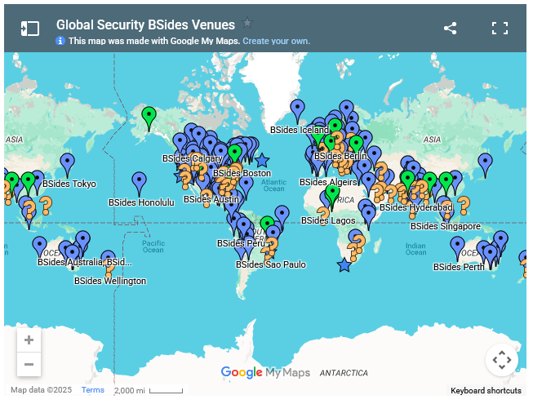

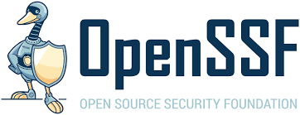
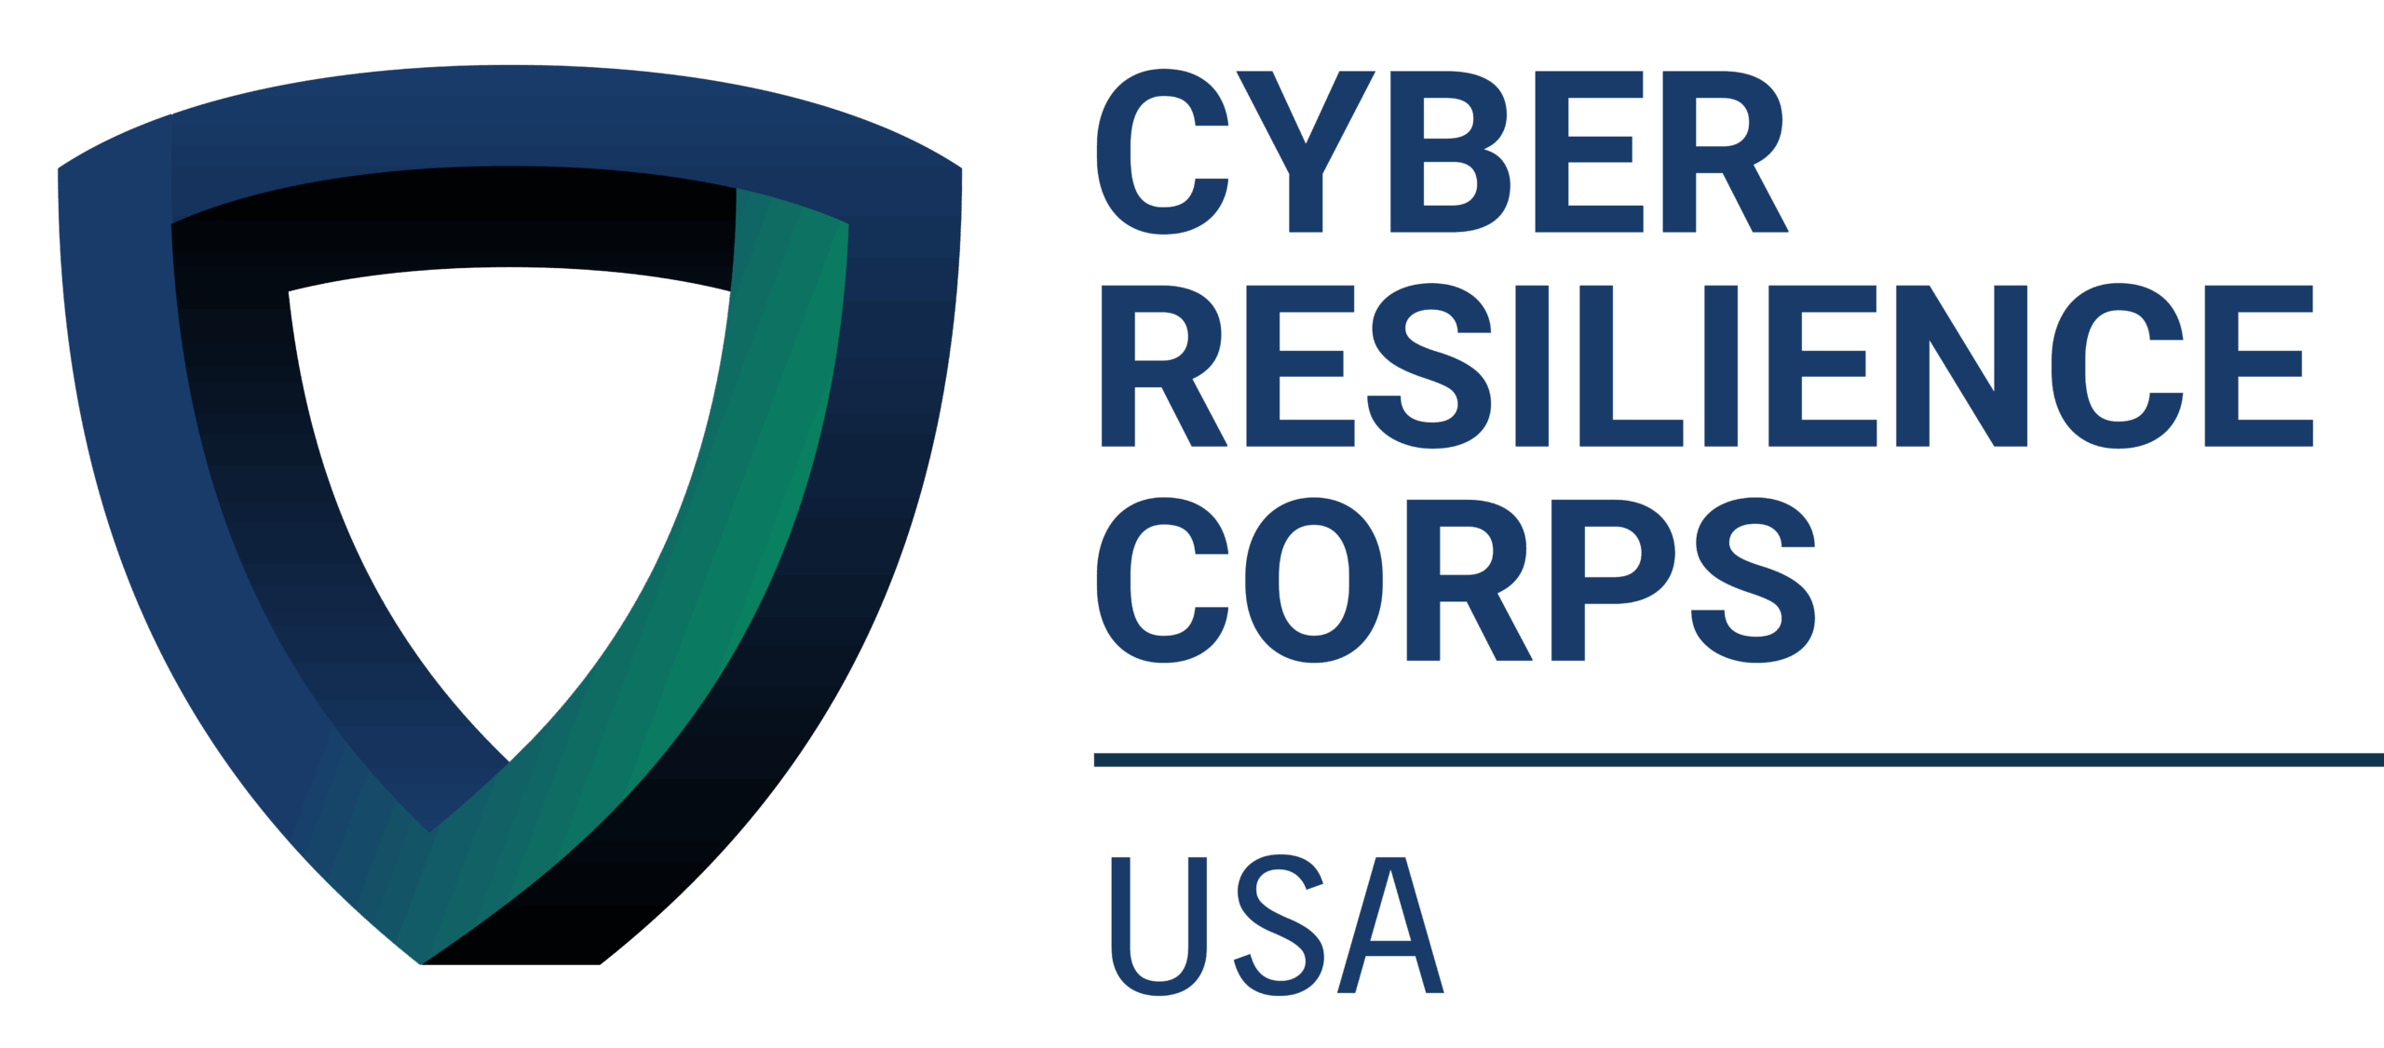



We Can Self-Organize
Notes:
First of all, we can self-organize.
Literally, look around. The beauty of hacker summer camp (not counting Black Hat) comes from a practically all-volunteer effort to organize four conferences, where we defer to each other based on reputation, expertise, and commitment to getting stuff done. As a community, we’ve bought into these models of self-governance and volunteer expertise – especially in the leadership of BSides and many of the villages – not because we had to, but because we’re practitioners who recognize skill when we see it and can (and will) call BS when it’s not there.
Similar models of practitioner driven self-governance, with deference to trusted community leaders, can be found in open-source foundations and projects that that serve as cornerstones of much of our work – all without a CEO or shareholders making us do it for a paycheck or stock equity!
We’re also organizing ourselves as volunteers to provide our skills and labor to the parts of our communities that need it most through initiatives like the Cyber Resilience Corps and DEF CON Franklin.
We also know how to organize ourselves into kick-butt affinity groups to support each other and build sub-communities that make the overall cybersecurity community bigger, stronger, and more inclusive. Again, we did all of that on our own and for each other!

Slide 12

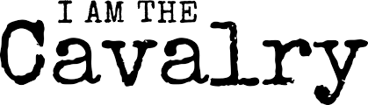
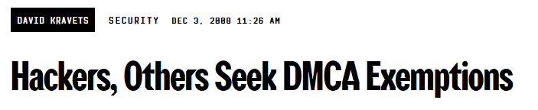
We Can Advocate
Notes:
We also know how to advocate outside our community without waiting for someone to swoop in and do it for us.
Hackers on the Hill organizers hackers to meet with members of Congress and their staff every year.
I am the Cavalry is downstairs building connections between our community and critical infrastructure communities - and advocating for critical infrastructure to get the resources and incentives it needs.
Going back to the 2000s, we’ve been self-organizing to advocate for policy changes that would let us do public-interest work without fear of criminal penalties from Section 1201 of the DMCA

Slide 13
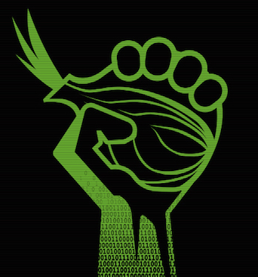
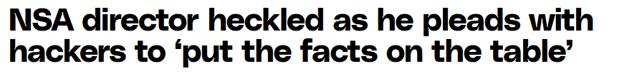

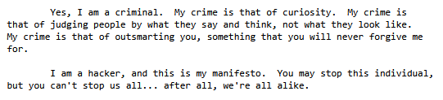
We’re Outspoken & Autonomous
Notes:
As far as values, we’re an outspoken bunch and we value autonomy.
We’re certainly not afraid to tell those in power what we think, or to call BS when we smell it.
Since the 90s, we’ve been telling politicians they don’t know what they’re doing to their face and ensuring the hacker voice is heard by policymakers.
We also love our autonomy. We’re certainly not afraid to stand out from the crowd, and we put a lot of work into building and supporting systems like Tor and Signal that let us privately communicate and maintain autonomy in the face of government and corporate surveillance.
Since the hacker manifesto, we’ve explicitly recognized that our ability to challenge entrenched systems comes from individual thinking, but – crucially - that we must also work together to preserve our ability to act as individuals.

Slide 14
Back to Those Union Things
Notes:
So, great, what does this all have to do with unions?

Slide 15
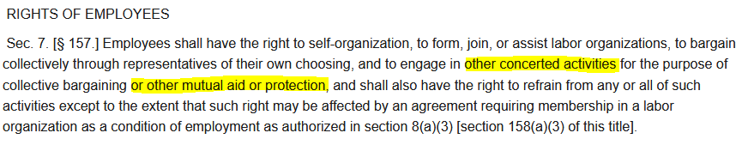
Unions 101
(U.S. Private Sector)
Excludes managers and independent contractors
Notes:
Legally, this is what a union or “labor organization” is in the United States. In its most basic form, a union is any organization outside of your employer’s control that you and your colleagues elect to represent you in negotiations with your employer. While the law spells out stereotypical bargaining categories – “grievances, pay, hours, benefits” I want to draw attention to “conditions of work” and encourage you to think creatively about what conditions of work could mean for us as hackers.
As, if not more importantly, are your legal rights as an employee. In addition to being able to form, join, or assist a union without reprisal from your employer, you have labor rights with or without a union. Specifically, you have right to engage in “other concerted activities” for “mutual aid or protection”, which I’ll touch on more in a moment.
Unfortunately, United States labor law also sucks in a lot of ways and excludes managers and independent contractors from having any of these rights.

Slide 16
Unions 101
(U.S. Private Sector)
Unions on the Job: A Village With Legal Power At Your Job
Majority of covered workers decide to form a union and elect leaders
Union bargains a contract for all covered workers
Specific subset of employees;
All employees at employer (“industry unions”); and/or
All members under all covered employers (“craft unions”)
Union files grievances over contract and law violations; represents members in advocacy activities
Notes:
If you’re interested in forming a union at your job, here’s an incredibly simplified overview of what that process looks like. If you’ve ever organized a standing, interest-based group within our community like a village, this shouldn’t seem too unfamiliar.
First, a majority of workers organize, decide to form a union, and decide what structure that union will take. This can include deciding who you want to be included in the scope of your union (a single team, an office location, your entire company), which larger union you want to affiliate with or if you want to start your own, and which colleagues you want running the union, bargaining on your behalf, and representing you in conflicts with your employer.
If you can run a non-profit, manage a CFP, and run a village or conference in the mayhem of the Las Vegas heat, you can do this.
After the union is recognized (which is a really hard part of it), you bargain a contract that covers everyone in the Union – regardless of if they voted for the Union or are active members. Bargaining is where your boss is legally required to reach an agreement with your dedicated representatives. Bargaining is where you can tell your CIO, HR department, and every other leader visited by the Good Idea Fairy or useless management consultants that their ideas are as workable as an intel executable on a new Mac - and you won’t agree to it. It’s a wonderful feeling.
The form of this contract and bargaining can vary depending on how you decided to structure your Union in Step 1.
It could be a specific group of employees within your organization – maybe the SOC team organized to get better pay, schedules, on-call treatment, or AI protections, and they’re negotiating a contract that just covers the SOC team. For example, CODE-CWA organized the Accenture workers contracted for Google’s Content Team and QA workers at Blizzard.
It could be all employees at your employer, as is more typical in small-to-medium businesses and white-collar employers, where everyone joins the same union regardless of team or position. These industrial unions are powerful because it allows you to bargain and along your employer’s entire line of operations and not as easily lose to “divide and conquer” strategies. This could be everyone at your small pen-test company deciding to unionize to get guaranteed training opportunities and a clear salary scale.
Finally, these are craft unions that negotiate master contracts with multiple employers. These are extremely rare in new unions and are mainly in the building trades, but worth thinking about for our industry where we take the same set of skills across multiple employers with frequent job rotation. I don’t see this happening in our industry anytime soon given these contracts tend to organized geographically, but it’s an option.
After you have your contract, your union represents you if your employer violates the contract or laws that protect you at work, and advocates for your interests beyond the workplace, which I’ll touch on more in a few slides.

Slide 17
Unions 101
(U.S. Private Sector)
No union? No problem. We’ve got solidarity.
Activities with one or more (sometimes just one) employee to improve conditions for any other employee (at any employer) is legally protected without a formal union
For example:
Talking about unions or wages
Confronting your boss
Refusing to work in unsafe or abusive conditions
File complaints over violations to the National Labor Relations Board
Notes:
Don’t have a union but still want to improve your workplace? That’s where those other rights come in!
Your right to engage in concerted activity for mutual aid and protection lets you put those skills you’ve gained heckling NSA directors to legally protected use – if you are doing it with or for a friend and it’s related to your status as employees. This area of labor law has a lot of niche rules and fuzzy lines, so ask around before doing anything too risky.
Some things you can probably do without a union:
Talking about unions and wages are categorically protected – it’s illegal for your employer to have a policy forbidding it if they let you talk about any other non-work subject.
You have the right to collectively confront your boss about your work. Your boss can setup zoom meetings with HR to ambush you – you and your colleagues have the right to do the same.
You can strike without a union! You and your coworkers can agree not to work, including when you’re needed most, to pressure your boss over an egregious working condition. If you’re working 18-hour incident response shifts, you and your colleagues can refuse to work the next one until your boss provides safe staffing levels.
If and when your rights are violated by your employer, you can file a complaint with the National Labor Relations Board who will provide an attorney to prosecute the case for you.

Slide 18
Unions 101
(U.S. Public Sector)
Key Differences:
Forget that mutual aid stuff or striking
But add whistleblower protections (including for managers)
Less bargaining over pay and benefits – more Congressional advocacy (feds)
President can (try to) exclude agencies and positions for “national security”
Sorry spooks ☹
State & local workers: differs by state
Notes:
For my fellow feds, there are unfortunately some key differences between us and the private sector where we have fewer rights. However, the first slide about forming a union then bargaining and enforcing a contract is basically the same.
First, we do not have those mutual aid and protection rights, so we can’t (legally) be as creative or disruptive. We also can’t legally strike.
But! We get stronger and more vigorous whistleblower protections for individual concerns, and managers get them too! Private sector folks you still get some, but I am not an expert.
We also usually don’t bargain pay and benefits – certainly not if you’re on the GS scale, though some independent agencies bargain pay – but unions provide an institutional voice to lobby pay and benefits with Congress
Aaand the President can exclude agencies or components from collective bargaining rights for “national security” reasons – or at least try to when it’s not clearly pretext to attack the unions that are fighting against his illegal actions.
Finally, for state and local workers, it really differs by each state and goes from no rights to all the rights.

Slide 19
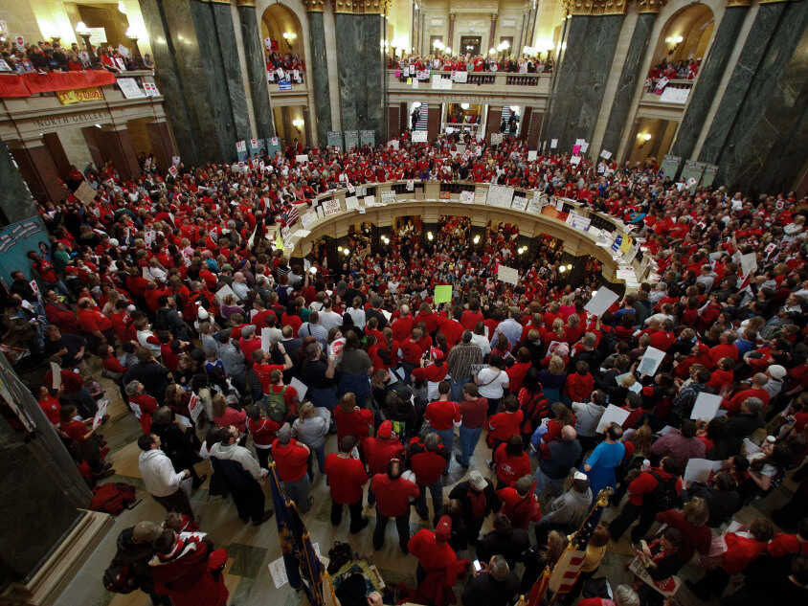
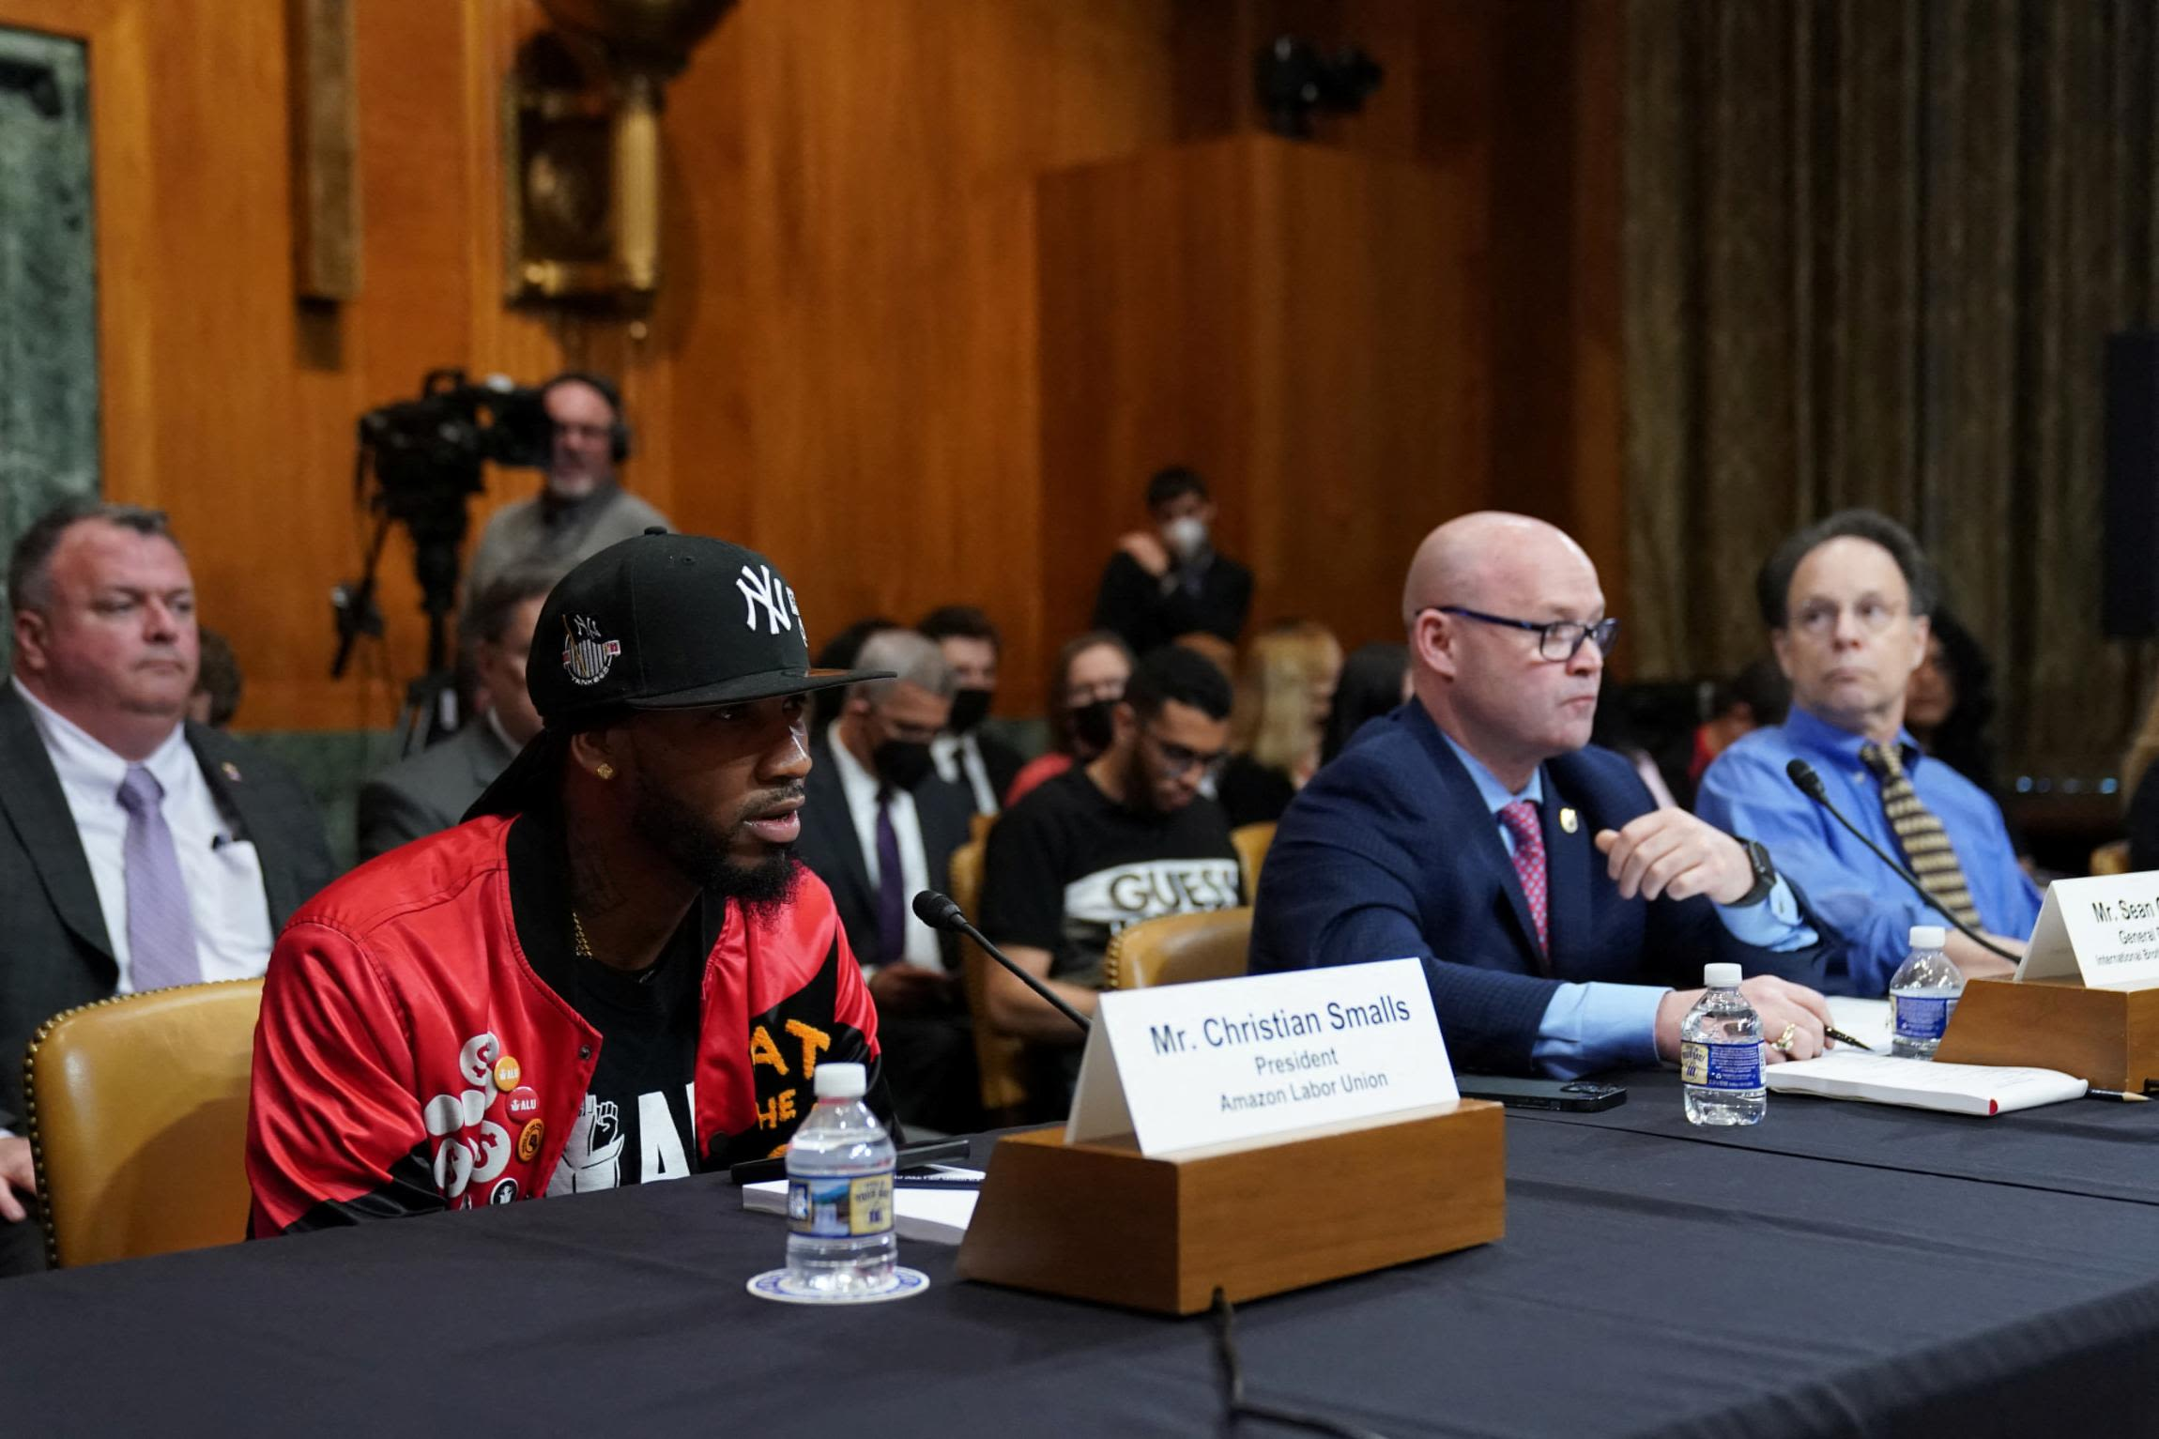
Unions 101
14.3 Million Members = 14.3 Million Voters = Political Power
Notes:
As I alluded to earlier, unions don’t just exist in the workplace – they are advocacy organization that, yes, advocate through legally-binding contracts that cover a job – but also advocate for broader policy change and political power that benefits their members and working people.
As good as we hackers may be getting at advocacy, we simply don’t have the numbers that you get from building a coalition with working people across the country.
Unions’ membership numbers and genuine ability to mobilize their members make then an institutionally recognized force at levels of politics and create an effective leverage point to push policy positions.
Larger unions or groups of unions are happy to carry water for niche interests among their members, especially if they don’t conflict with their other members’ interests. In other terms, unions have a robust policy C2 infrastructure in place, which we could reuse to deliver our messages. We could dramatically improve our leverage by making critical infrastructure protection, right to repair, robust cybersecurity and privacy protections, and DMCA reform workers’ issues – not just hackers’ issues.

Slide 20
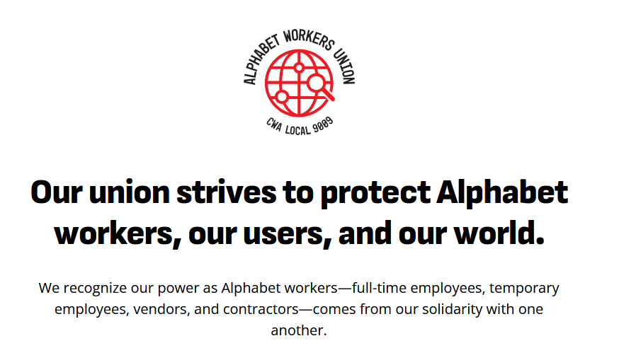
Success Stories
Notes:
To move from abstract details to successes in or near our industry, the Alphabet Workers Union has won significant changes at Google without and exclusive union.
They have formed a pre-majority union, so they have not had an election to become the exclusive representative of Google or other Alphabet workers that Alphabet is required to bargain with. Instead, they are organizing across Google employees, contractors, and vendors to pressure concessions from Google.
They got the National Labor Relations Board to overturn a gag order on employees from discussing Google’s anti-trust case, affirming employee’s inherent right to discuss their working conditions with or without a union contract.
They pressured Google to use voluntary buy-outs instead of layoffs during the recent tech industry layoff wave.
They got Google to extend the deadline for its Return to Office policy, allowing workers more flexibility to change their living situation or find a new job.
And, as briefly mentioned, they did win exclusive recognition with an Accenture contract team in Google’s Content division.

Slide 21
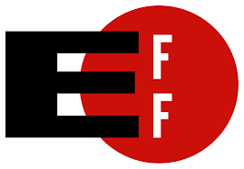
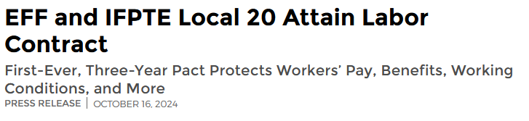
Success Stories
Organized to maintain good working conditions with a binding contract
Won guaranteed remote work, commitment to DEI, transparent pay scales and raises, anti-bossware commitments, and rental assistance
Notes:
This small, relatively unheard of non-profit – especially here - called the Electronic Frontier Foundation formed a union around two years ago and agreed to their first contract in October!
From what I’m told (and read online) EFF staff organized not in response to bad conditions or a specific threat, but to take the good conditions they already had out of their leadership’s complete discretion and into a binding contract.
In typical EFF fashion, they were awesome and posted their contract online, so anyone can lookup their fantastic wins including remote work, employee and management engagement in DEI initiatives, clear pay scales and raise structures, anti-bossware guarantees, and rental assistance for employees in the Bay Area.
Many kudos to Cindy Cohen and EFF leadership for walking the talk on their values, and many more kudos to the EFF staff who took the step to organize and win a robust contract – it makes me proud to be a member.

Slide 22
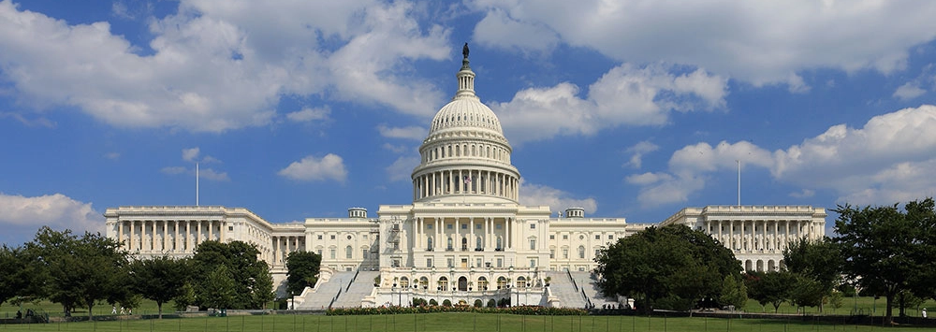
Success Stories
Organized after unilateral, unpopular changes from agency head
Won remote / flexible work (and fighting to hold onto it)
Ensured effective and employee-centered AI deployments with in-house models
Bargained over effective security control implementation
Notes:
At my organization, we had a more typical union origin story many, many years ago – before I started there.
We organized when a new leader came in and started making unilateral, unpopular changes that prompted employees to form a union so that boss couldn’t make additional unpopular changes without a fight.
Since then, we’ve also won remote and flexible work as a contractual guarantee and are fighting to ensure what is still a legally valid contract is fully enforced
We’ve bargained over technology rollouts, including AI, to ensure they benefited how we got our work done and weren’t a hair-brained management disruption onto how we actually do our jobs
And while security is a management right, we still get to bargain how security controls are implemented when they affect working conditions. It’s in discussions like this where the power of having a multidisciplinary union shines. I can dig into the technical specifics of the change and communicate the importance of robust security controls to my colleagues, while my colleagues can point out how changes will be interpreted by non-technical employees and harm the agency’s mission work. For management, technical bargaining is essentially a free consultancy, user feedback session, and rollout fix for the issues they can’t fix because managers don’t cooperate across organizational silos, but the union does.

Slide 23
Counter Arguments
“Labor law gets violated all the time!”
“We’ll be outsourced or fired if we unionize!”
“Unions are corrupt and/or ineffective!”
“Union leaders don’t know technology and are luddites!”
“Unions will take my dues for nothing!”
“Unions take my autonomy!”
They’re still your rights, and our power comes from being organized – not the law.
You’ll be outsourced anyways if it’s cheaper + illegal + protections
Unions are democracies – they answer to you when you demand it
Unions can balance tech workers’ and impacted workers’ interests
A union contract pays for itself + money for new organizing and advocacy reinvests
Unions stop your boss from taking your autonomy, and are a vehicle for yours
Notes:
Despite these success stories, I know many folks still have reservations about unions, or specifically about unions in high-paying, high-skilled, or technical work, so let’s walk through some common ones:
These rights you talk about don’t matter, because employers violate them all the time.
It is true that employers violate the law a lot for pretty much every right I’ve mentioned in this talk. It can take years for a complaint to be processed by the NLRB, and the remedy is essentially a slap on the wrist for employers. In the meantime, employers frequently use that processing time to try to shut down union organizing or fire an organizer. That said, they’re still your rights, and while they may be hard to enforce, they’ll go away entirely if you don’t use them. More importantly, the legal enforcement of labor law hasn’t been where unions get their power. Unions get our people from people and from organizing. While legal enforcement can be a handy backstop, power over your boss comes from a) the labor you provide that they need to create value and 2) the leverage you and your colleagues can apply on your employer’s other stakeholders that make it painful for them to be uncooperative.
Unionizing leads to outsourcing or being fired.
First of all, it’s illegal for an employer to retaliate against a unionization effort or any employee demands with outsourcing, offshoring or threats to do either. Moreover, if it’s cheaper for your employer to offshore you and they don’t respect you enough to negotiate with you over your concerns, then they’re probably going to do it anyway. They may do it slowly, where it’s harder to organize against and stop because there’s no flash point for organizing. But if your boss is feeling pressure to cut costs, then keeping your head down won’t protect you. Organizing - and making it painful for them to make cuts - will.
Unions are corrupt or ineffective
While some unions were historically corrupt, and some of the larger unions have not been as effective in organizing as I would like, they are ultimately democracies. The smaller and closer to workers your union’s structure is, the more responsive it will be to your concerns, and you can always run against an ineffective leader, organize around them, or even vote to be represented by a different union. You can’t outvote your boss
Union leaders are luddites!
Hey, don’t knock the luddites – read Blood in the Machine for a good historical perspective on workers’ fight to control their work in hyper-exploitative conditions. Most unions want to make their members’ jobs easier and will happily embrace technology that does that. To the extent technology threatens their members’ existing jobs or work, unions can serve as democratic forums for technologists and impacted workers to hash out an ideal alignment with a fair transition and clear pathways for workers.
Unions will take and waste dues money
Your dues money will more than pay for itself in pay and benefit increases. That money also goes to organize more workers, making the labor market even more competitive when more workers are organized. Dues money also helps unions advocate for issues that raise wage floors.
Unions will take away my autonomy by eliminating privileges for high-performers and destroy my relationship with my boss!
The current level of autonomy you feel is because your boss has decided to grant it to you, and they can take it away or threaten it when they decide they no longer need to offer it to you. By sacrificing a small amount of your autonomy to a collective contract, you build a shield that guarantees protections for you and your ability to act autonomously in the workplace. You also have autonomy within a union democracy to campaign against agreements you disagree with it.

Slide 24
It’s On Us
But Not Us Alone
Notes:
To tie things back to the current moment, we are in a unique position as information security workers to protect each other and our communities, and we’ll only get there if each one of us decides to do something about it.
We are in a lovely paradox where our individual actions won’t save us, but we’ll only build sufficient collective action if each of us, as individuals, does something. Thankfully, there are movements with the infrastructure and community to support us, and we won’t have to do it alone.

Slide 25

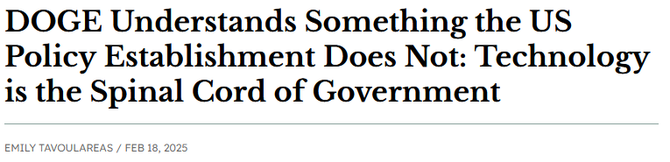
It’s On Us To Stop Shit
We’re the bones
We can either enable or slow the abuse of systems, but not alone
Our labor is essential to protect our boss’ assets
Enshittification Blockers:
Competition
Regulation (?)
Interoperability (?)
Workers
Notes:
For us specifically, we are uniquely positioned as information security professionals because everything is, in fact, computer.
Computers are how policy is turned into material reality, how payments reach our neighbors, and how social interactions are mediated. As I argued at the top of the talk, the current form of totalitarianism realized this and really wants complete and total control over the computers with no ability for us to use our labor to dissent. They do not have enough people with the combination of competence and loyalty required to meet their objectives by themselves, so they want us to get inline and be afraid of them.
If computers are the spinal cord of government, and most organizations, infosec is the bones protecting it and ensuring the nerves stay in place. Given our positions of control over these systems, we can either rapidly allow bad actors to get in or enforce the guardrails that should be in place. If we try to do it as individuals, they’ll just fire us and replace us with the next person who will. If we organize our responses, they have to spend time fighting us that they’d rather spend using what we built to screw over our neighbors.
As InfoSec workers, we’re also uniquely positioned to force concessions from our bosses. By the time we’re being hired, our bosses have highly valuable assets they want to protect. The marginal losses of losing those assets from an incident that happens when we all strike or get fired vastly outweighs the marginal costs of our demands, giving us much more leverage than the average tech worker who makes new stuff.
If we look to Cory Doctorow’s causal theory of enshittification, enshittification is prevented by strong competition, regulation, interoperability, and worker power. We can can’t count on increased anti-trust enforcement over the next four years and will only see some state regulations and interoperability requirements at best. Our leverage as workers is the only systemic lever we can count on not being captured, and we’re the only ones that can pull it.

Slide 26
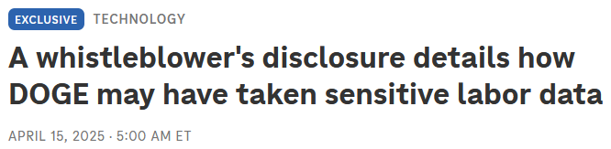
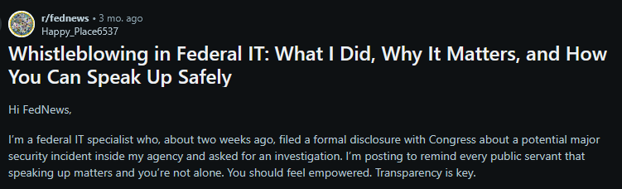
It’s On Us To Stop Shit
Your Rights > Your NDA
Notes:
Don’t just take my word for it, take the word of Daniel Berulis, a cybersecurity professional at the National Labor Relations Board who blew the whistle on suspicious activity in their Azure environment. Him and maybe one or two other people were the only ones with the visibility into these systems – no one else could have flagged this. In his words, you’re not alone and you have rights that empower you.
Your rights to speak out about your workplace conditions and legally blow the whistle, as Google workers and Dan showed, carries more weight than your NDA or corporate policy. Our bosses may want us to feel like atomized individuals, but we’re not, and there’s a community that has each others’ back when we step up.

Slide 27
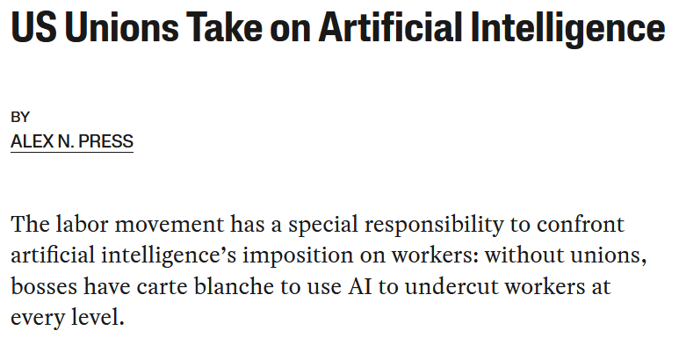
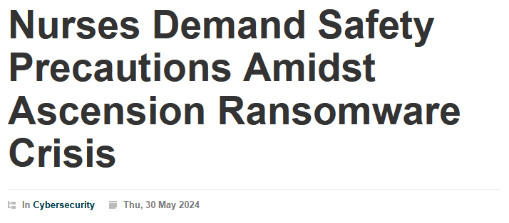
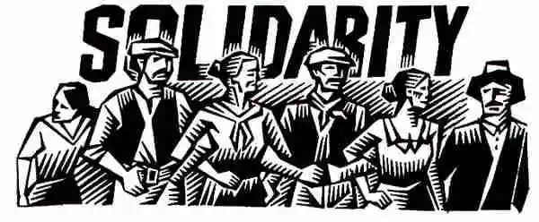
And We’ve Got Friends
Notes:
And that community isn’t waiting for us either. The labor movement has recognized that privacy rights are workers’ rights. Unions, with the help of community allies like EFF, have been leading the legal fight against DOGE’s invasions into our privacy
Unions have been leading the way into bargaining fair AI use into their contracts, and advocating for policy restraints on AI controlling and surveilling us at work instead of the other way around.
When ransomware incidents strike, other unions have been creatively showing what it looks like to demand an effective and transparent response and ensure a properly-resourced cybersecurity program to protect their working conditions.
There are large swaths of workers, in every field, who are ready and willing to be in solidarity with us.

Slide 28
For Managers
Let your employees unionize!
You’ll get less turnover, more psychological safety (with better ideas), honest feedback, and fewer insider threats
Then bargain in good faith!
Proactively solicit input (and materially respond to it)
Support other unions in private and public
Join and support other civil society organizations
Increase labor market competition (be a good employer)
Notes:
RELATIONSHIPS AND SOLIDARITY
[Quickly cover bullet points]

Slide 29
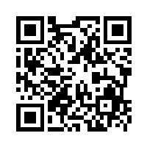



Resources
Tech Workers Coalition: https://techworkerscoalition.org/subscribe/
Join Us in #cybersecurity on the Slack
Federal Unionist Network: https://www.federalunionists.net/join-us/
Emergency Workplace Organizing Committee: https://workerorganizing.org/
Whistleblower Aid: https://whistlebloweraid.org/
Unions Organizing Tech Workers:
CODE-CWA: https://code-cwa.org/
OPEIU Local 1010: https://www.techworkersunion-1010.org/
IFPTE (tangentially): https://www.ifpte.org/
<- These slides, resources, and more:
https://github.com/LArkema/Unions
@LoganArkema
Notes:
Tech Workers Coalition is a grassroots organization of tech workers in unions, looking to form unions, or tap into the labor movement to improve working or our collective conditions
For federal workers, the Federal Unionist Network is a similar grassroots network of federal workers building a movement across federal unions and agencies to strengthen our unions and fight totalitarianism
Emergency Workplace Organizing Committee provides trainings and resources for workers trying to organize but who don’t have the support of a union yet
Whistleblower Aid will help you make protected disclosures about abuses at your workplace. Have worked with Mudge, Francis Haugen, Daniel Berulis @ NLRB, and other tech workers
Campaign to Organize Digital Employees, Communications Workers of America most active tech union. Campaigns at Google, Microsoft (esp. gaming industry), and Apple retail stores.
Office and Professional Employees International Union has a local dedicate to organizing tech workers
International Federation of Professional and Technical Engineers represents stem-adjacent workplaces and non-profits. Unions include tech workers, but not a focus.
Thanks to folks at my Union, TWC (Kara), and EFF (Cooper Quintin)
There’s a community and a movement that wants you to succeed and will have your back, but no one can do it for you. So go out there build relationships, organize, and tip your bartender. Thank you very much

